Slide 1
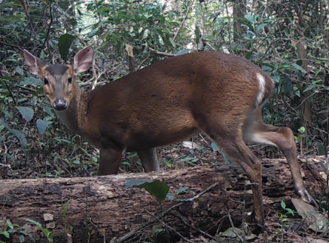
Image Processing for Camera Trap Images
Kyle Watts
Colorado State University
Fish, Wildlife, Conservation Biology

Slide 2
Introduction and Background
Difficult to study wildlife in tropical regions
Difficult to capture images of wildlife
Camera trap imaging helps but time consuming looking through empty data
Small % of images have animals, let alone target species
Adding metadata takes time

Slide 3
Objectives
To become more efficient working with Camera trap images
Allow filtering out of empty images based on confidence interval
Allow filtering for animals based on confidence interval
Improve speed of adding metadata to images by looking for boxes

Slide 4
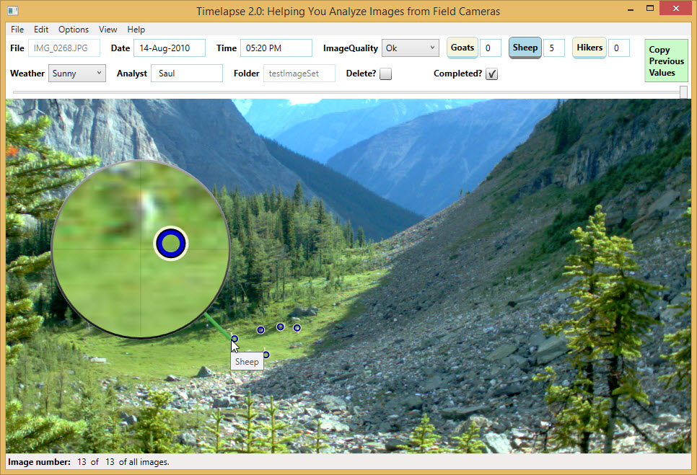
What is Timelapse2?
Image and video analyzer
Extracts and display metadata of the image such as dates and time
Supports visual enhancement and tools for analysis
Import/Export CSV and selection of images based on field inputs

Slide 5
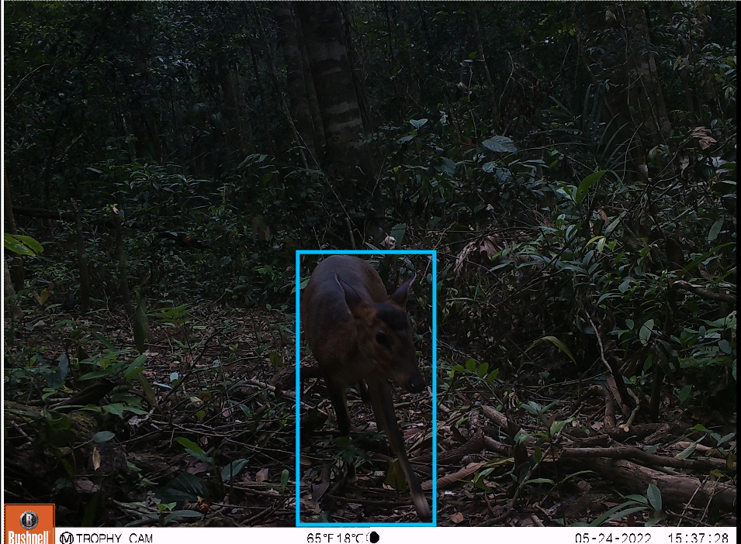
What is MegaDetector?
Machine learning model trained to detect animals, people, and vehicles
Not able to identify specific animal
Offers categories and confidence intervals that the category matches
Creates output text file over all images that can be used in programs like Timelapse2

Slide 6
Methodology
Image Folders
MegaDetector Model
Output JSON Response
Import to Timelapse2
Select Category
Analyze Images

Slide 7
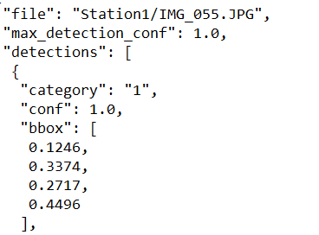
Methodology
Image Folders
MegaDetector Model
Output JSON Response
Import to Timelapse2
Select Category
Analyze Images

Slide 8
Methodology
Image Folders
MegaDetector Model
Output JSON Response
Import to Timelapse2
Select Category
Analyze Images

Slide 9
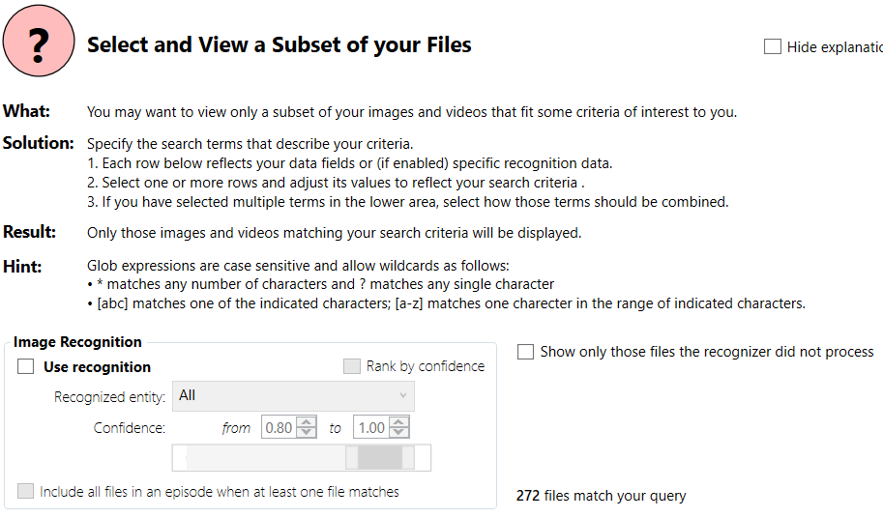
Methodology
Image Folders
MegaDetector Model
Output JSON Response
Import to Timelapse2
Select Category
Analyze Images

Slide 10
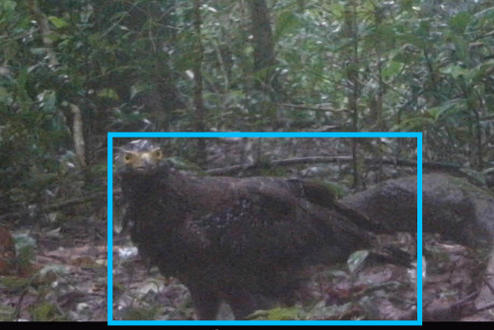
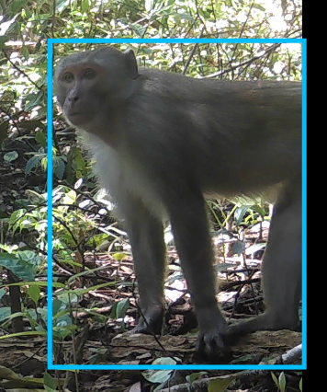
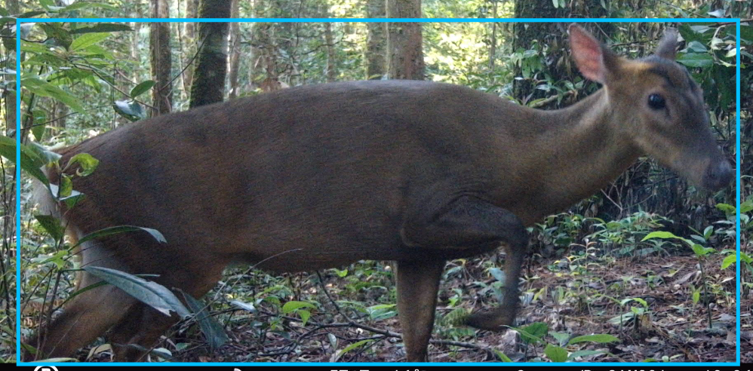
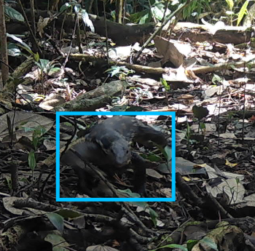
Methodology
Image Folders
MegaDetector Model
Output JSON Response
Import to Timelapse2
Select Category
Analyze Images

Slide 11
Use Case
Batch of 3 months of data: August – October
Number of images: 140,342
Needed an effective way to quickly go through all files
Looking for Large-Antlered Muntjac

Slide 12
Filtering on Empty

Slide 13
Filtering on Animal with 95% CI

Slide 14
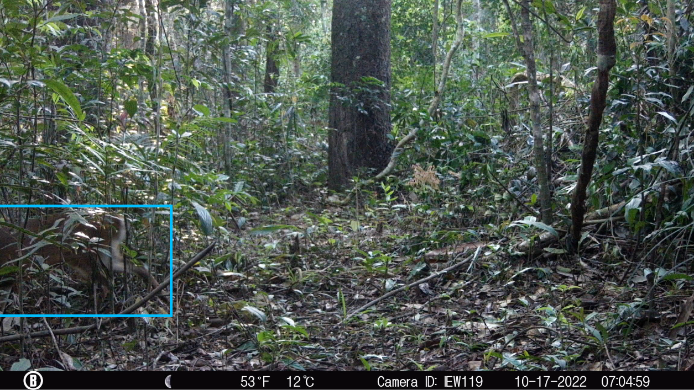
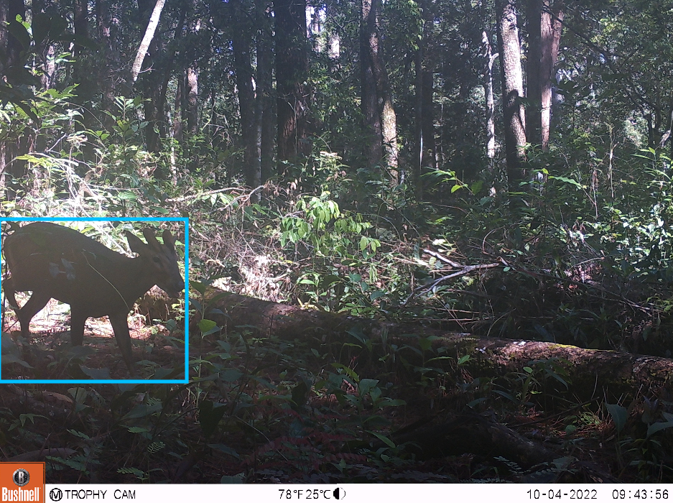
Filtering on Animal with 95% CI

Slide 15
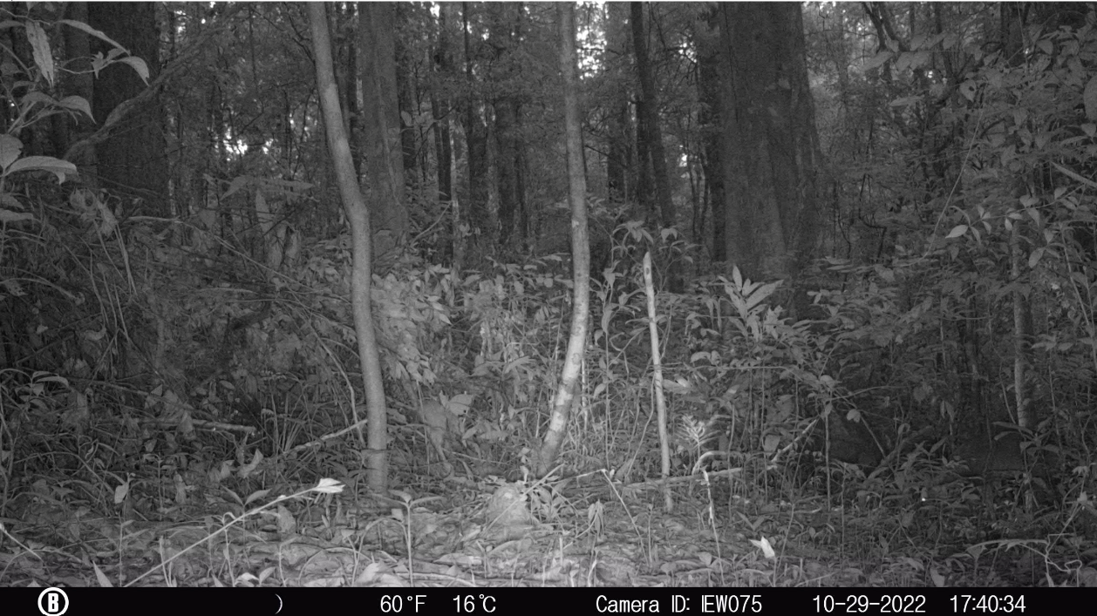
Example 1

Slide 16
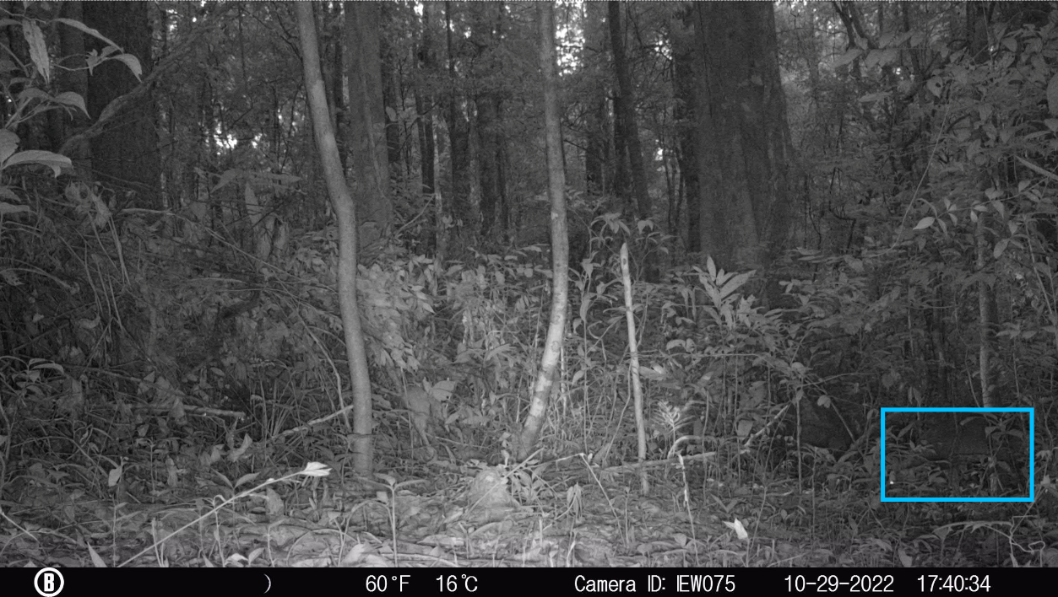
Example 1

Slide 17
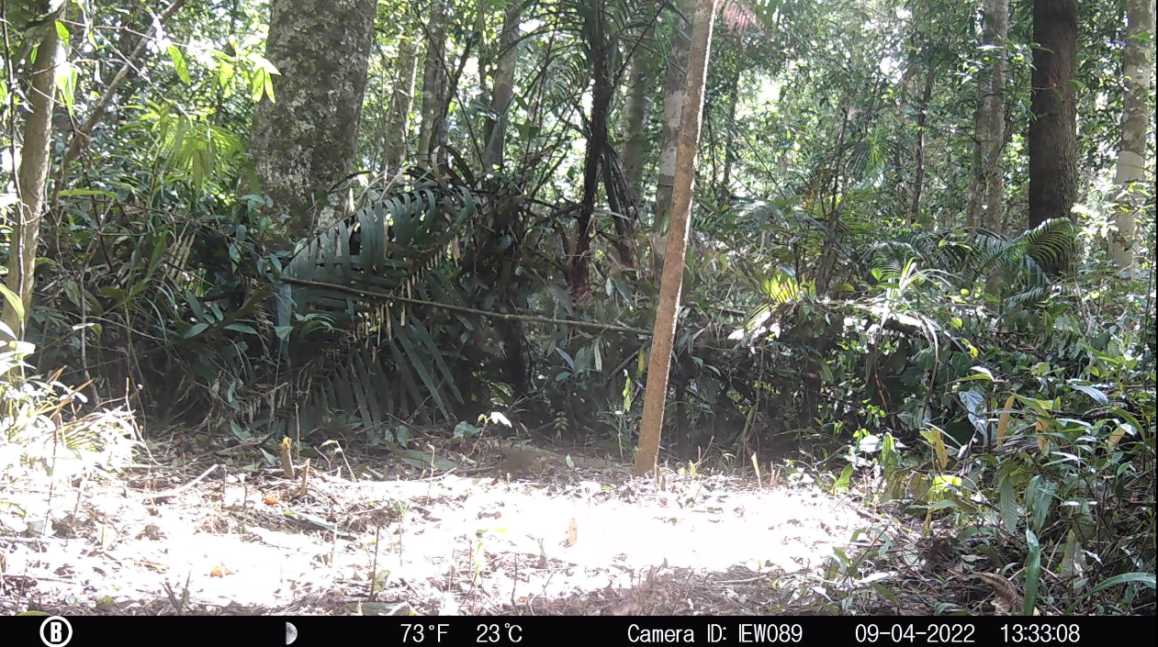
Example 2

Slide 18
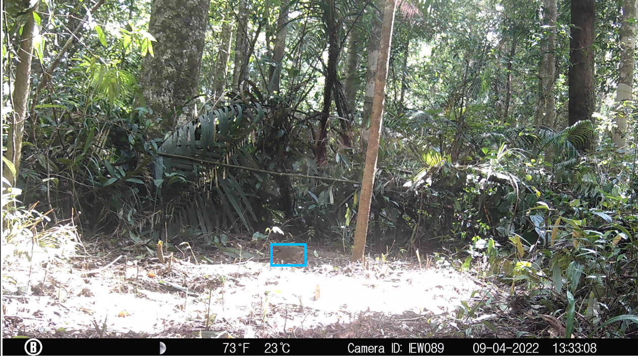
Example 2

Slide 19
Results
Out of 140,032 images
MegaDetector took ~26 hours to create output file
Confidence interval 50 to 100%
Category | Count | Total Makeup
Empty | 109,644 | 78.30 %
Animal | 24,616 | 17.58 %
People | 5,570 | 3.98 %
Vehicle | 32 | 0.02 %

Slide 20
Results
Out of 24,616 animal images
Confidence interval 50 to 100%
Category | Count | Total Makeup
Rat | 12,109 | 49.19 %
Squirrel/Shrew | 5,201 | 21.13 %
Large-Antlered Muntjac | 2,183 | 8.87 %
Chevrotain | 983 | 3. %

Slide 21
Can quickly navigate through empty images
Can look for bounding boxes to speed through images
Can spot things that humans would miss
Not 100% reliable – can create false boxes around areas of interest
Different biomes harder to process – rainforest one of the hardest
Not able to identify species – needs training models to be enhanced
Benefits
and
Limitations

Slide 22
What's next
Ever evolving technology
Organizations expanding interest
Other image integration
Relatively new
Google Vision AI, Microsoft AI Good Lab, WildEye, Wildlife Insight, WildTrax
Text OCR tools, PyTorchWildlife 2024

Slide 23
Acknowledgements and Citations
CSU
Minh Nguyen
Cecilia White
Joel Berger
MegaDetector
https://github.com/agentmorris/MegaDetector
https://github.com/microsoft/CameraTraps/tree/main
Timelapse2
https://saul.cpsc.ucalgary.ca/timelapse/pmwiki.php
Article published using both MegaDetector and Timpelapse2
Morton, J. (2023) Refuge Notebook: New technology increases efficiency of refuge cameras. Peninsula Clarion, April 6.

